Slide 1
TSRTM
Tractive system ready to move
By Vasily
Plz give suggestions and comments

Slide 2
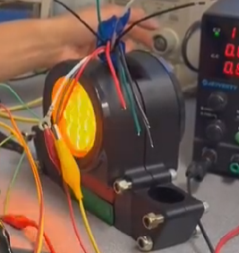
What is this circuit for?
As the high voltage side reaches threshold past 60 volts
Indicate that the system is powered on and warn others that high voltage is activated.
Flashing amber lights->

Slide 3
High Level Diagram/Explanation
What the schematic must have:
Some kind of Measurement of voltage
Logic to turn on amber when voltage reaches threshold
Logic to control duration and amber flash (most likely using 555 timer)
Mosfet or Relay to turn on amber light
High voltage terminals (positive and negative)
SYSTEM
Turn on or off amber light
12 volts input to power the circuit
*Note that low voltage and high voltage must be isolated (separated)

Slide 4
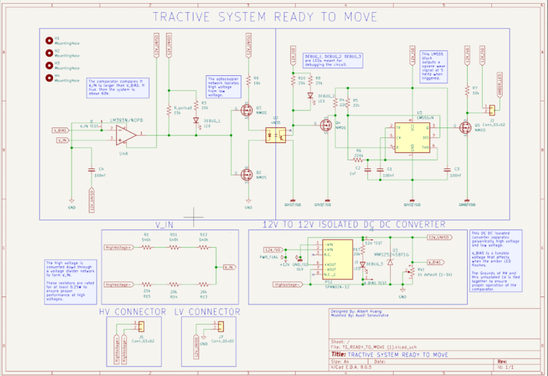
Core modules
Voltage comparator
Flashes the light
Voltage Divider
Voltage 12v to 12v Converter

Slide 5
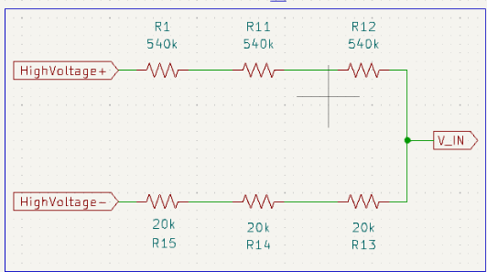
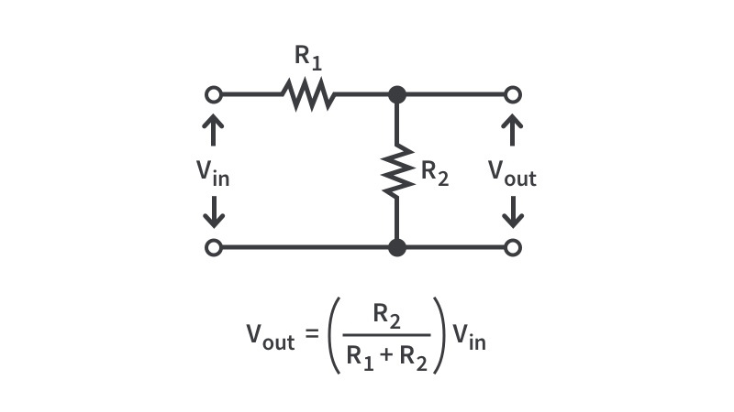
Why and how Voltage Divider works
Goal to convert voltage from 400 volts to 12 volts
This is then used for measurements
Math behind voltage dividers
Note voltage dividers are only for low currents such as reference voltages or very low current powering of devices

Slide 6
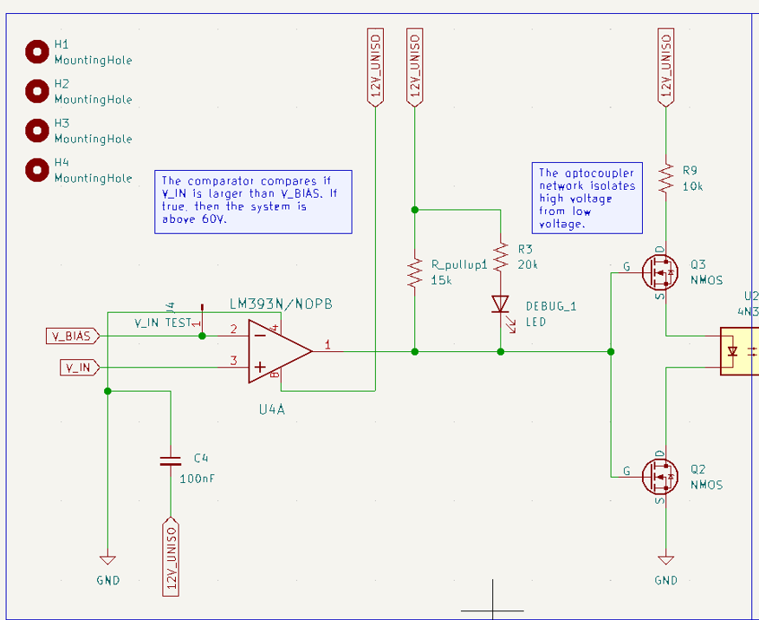
Why and How Voltage Comparator
Compares divided voltage to input voltage
Divide voltage
= 0 or 1
V reference voltage
If Vin < Vbias output is ground
If Vin > Vbias output is floating(then pulled up using pull up resistor)
Then output of comparator is connected to Nmos which turns on the optocoupler if voltage at gate is high
And using mosfets turn on the optocoupler

Slide 7
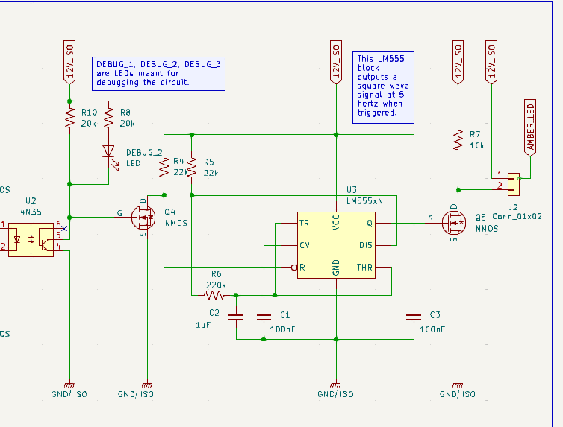
Why and How Amber LED
555 timer is used to trigger intermittent flash of the amber light
The amber light is pulsed to be on and off using N type MOSFET that connects and disconnects ground for the amber which turns it on and off.

Slide 8
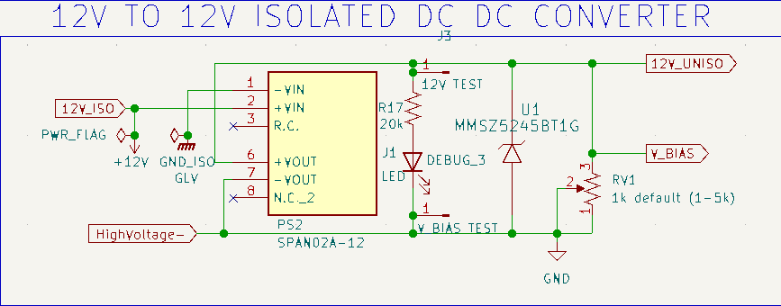
Why and how 12v Isolator
Separates high and low grounds
Common ground can cause:
cause noise and ground loops, can make logic circuitry not work. Complete electrical separation, not just separate wiring.
Thus this module separates input grounds to make sure logic works properly.
The outputs on high side of the circuit V_bias and HighVoltage devied down to voltage for comparator share the same ground (high side ground) for the comparator to work properly, comparator is also grounded to high side ground

Slide 9
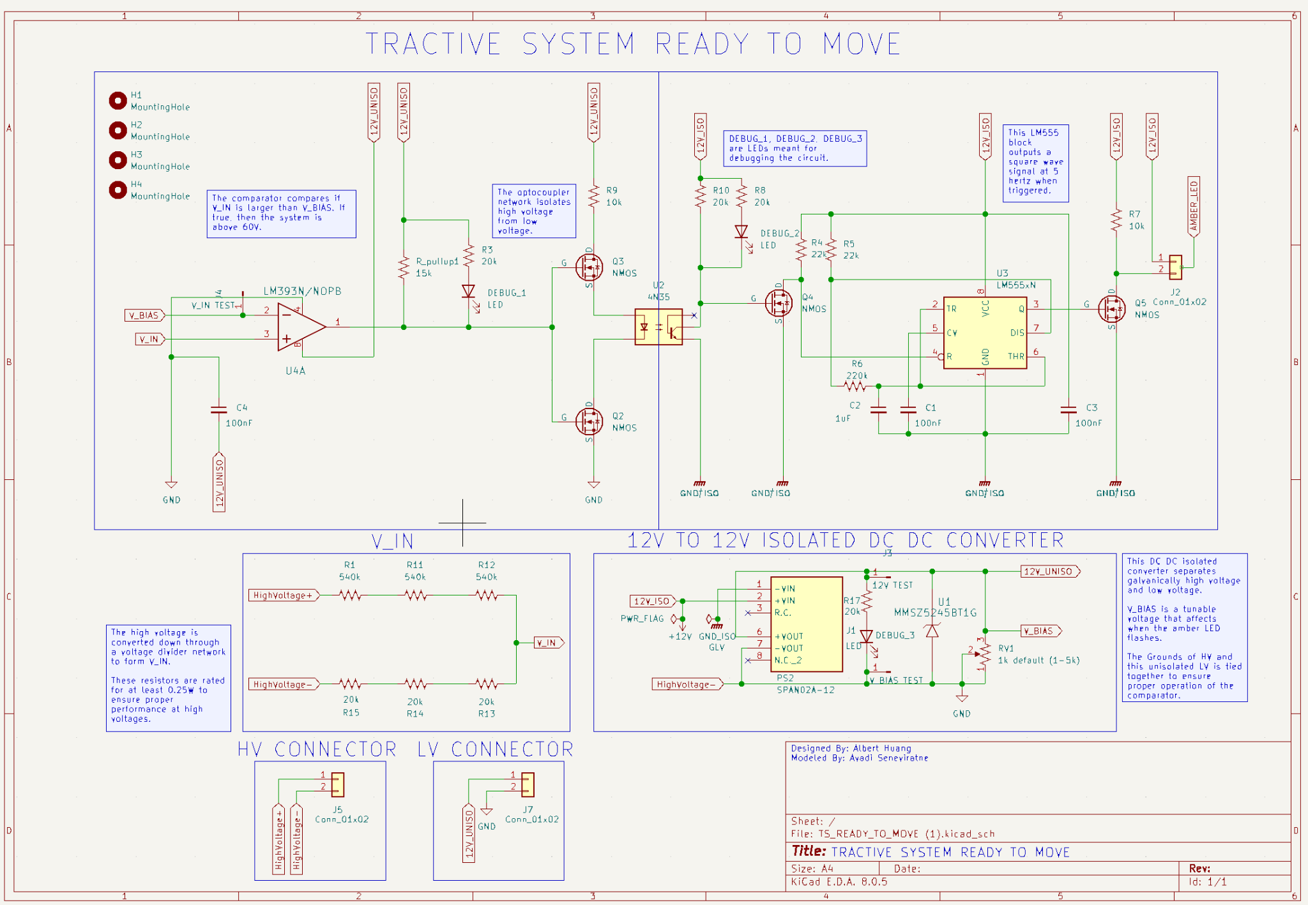
schematic

Slide 10
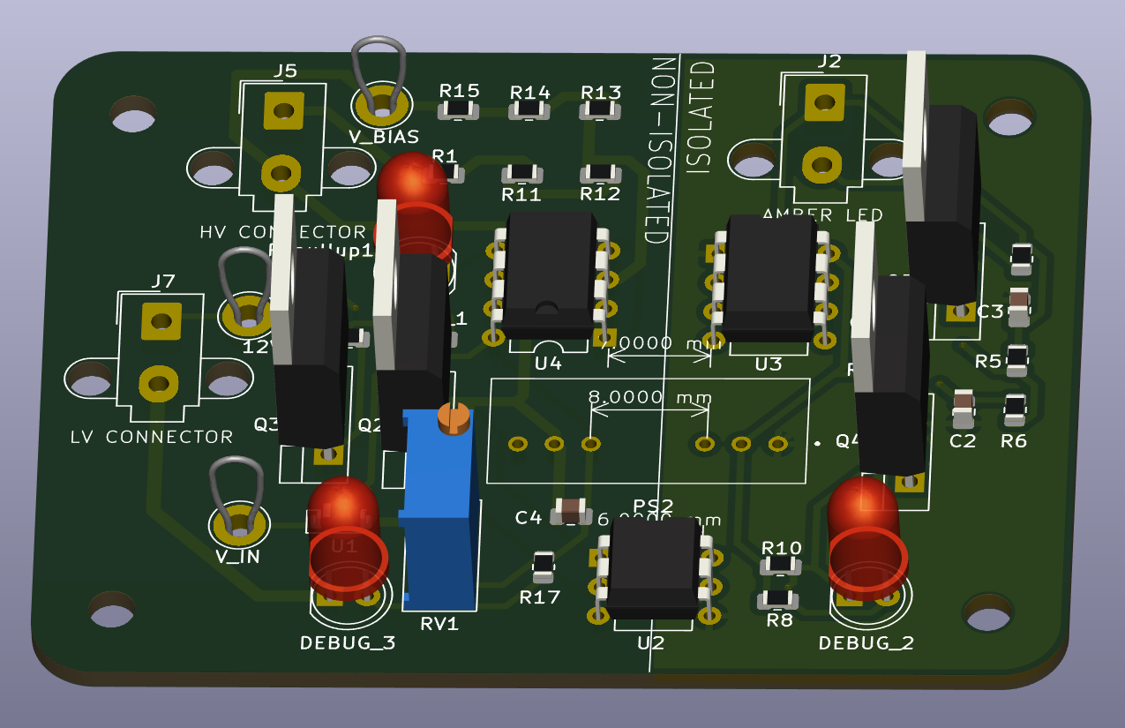
pcb

Slide 11
Potential ideas for improvement
Reducing number of mosfets to drive the optocoupler to just one Nmos on the bottom
Thus source channel of Nmos is always grounded and optocoupler connects to drain
(this slightly simplifies the circuit)

Slide 12
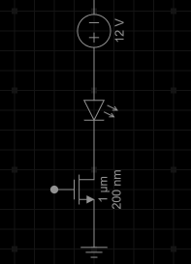
Potential ideas for improvement
Slight simplification of amber led turn on
Amber led

